Slide 1
Sketch-based 3D Modeling in Virtual Reality
Floor Verhoeven
Supervisor
Prof. Dr. Olga Sorkine-Hornung

Slide 2
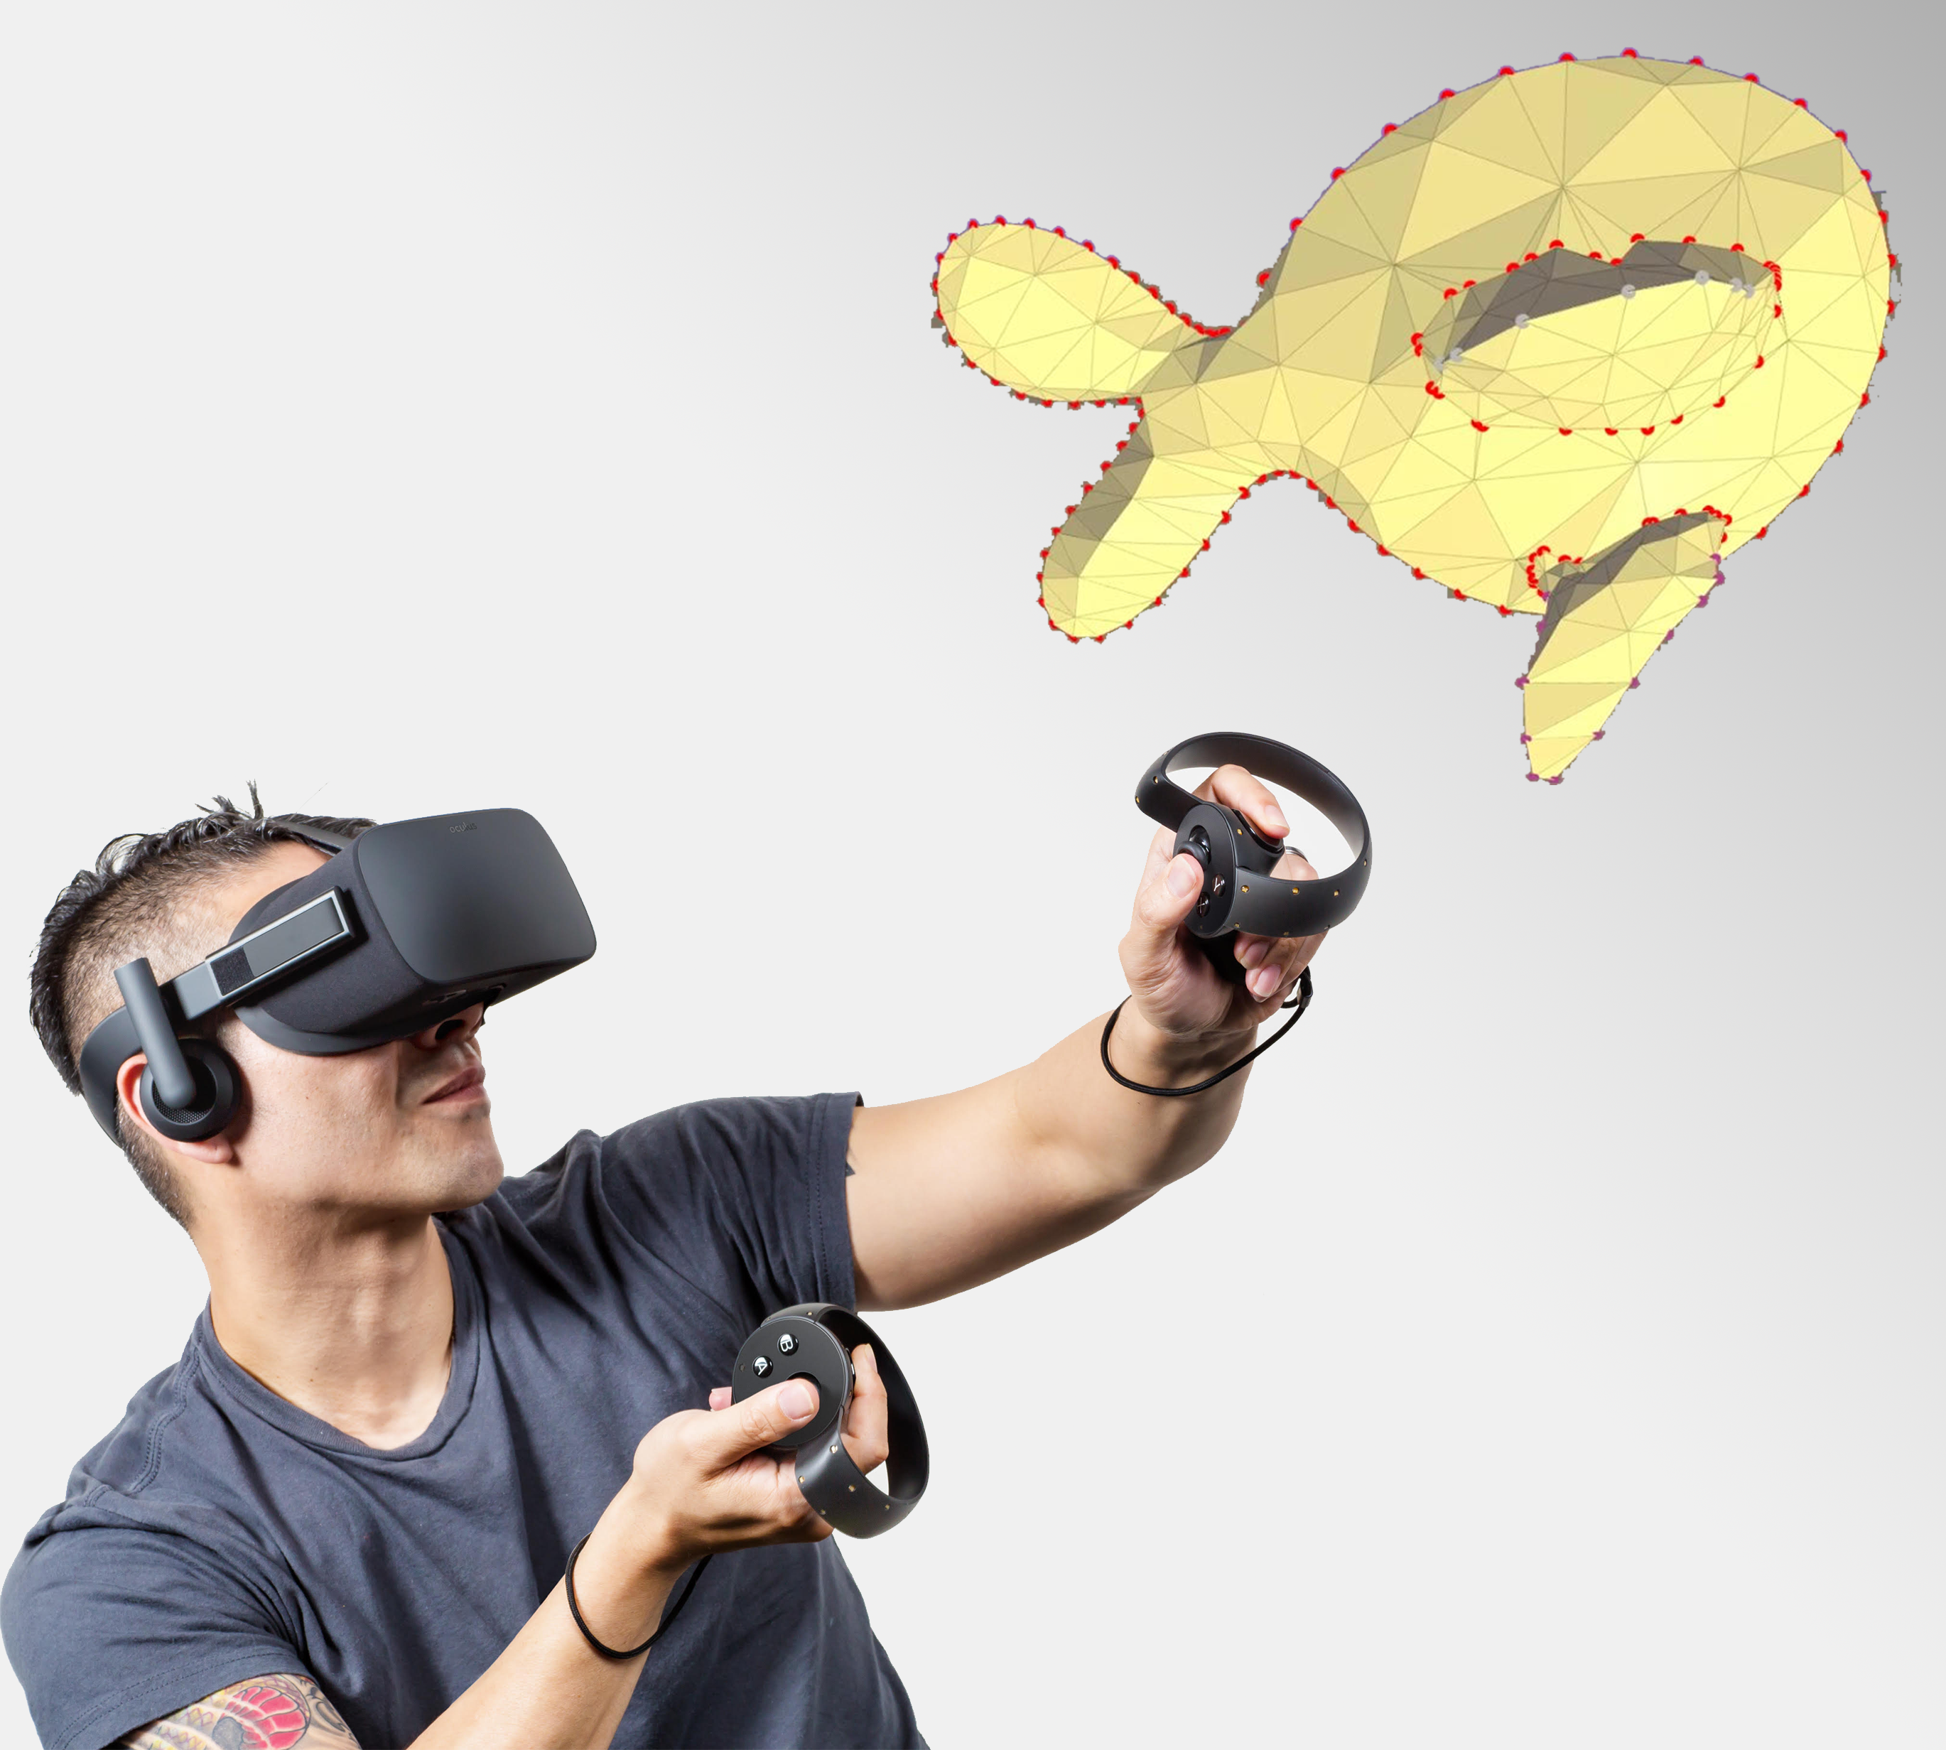
Introduction
VR for interactive 3D content
Intuitive sketch-based 3D modeling
Easy to use for beginners

Slide 3
Related Work

Slide 4
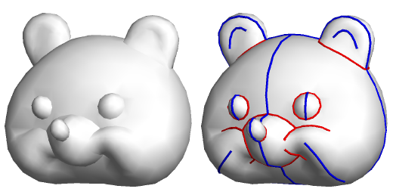
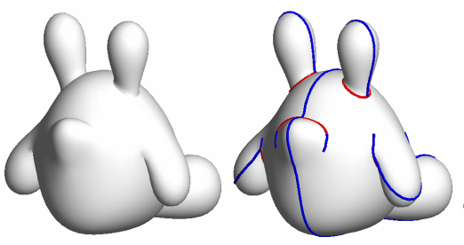
FiberMesh Nealen A., Igarashi T., Sorkine O., and Alexa M., 2007
Sketch-based 3D modeling
Functional optimization
Drawn curves serve as handles and functional constraints
Curve deformation & surface optimization

Slide 5
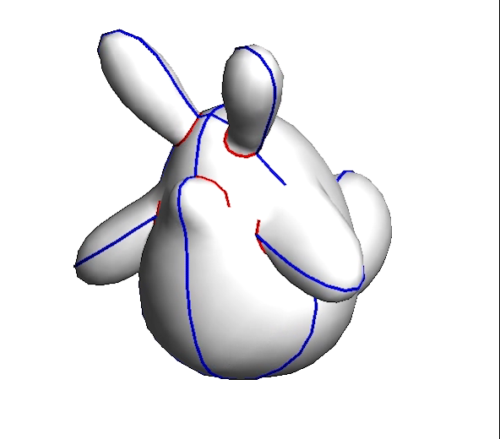
FiberMesh Nealen A., Igarashi T., Sorkine O., and Alexa M., 2007

Slide 6
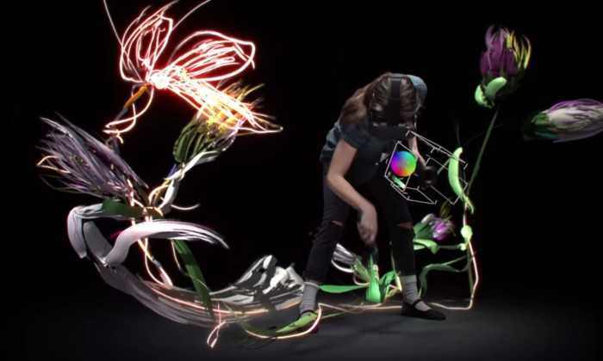

Google Tilt Brush
3D art in virtual reality
No exporting to 3D model formats

Slide 7
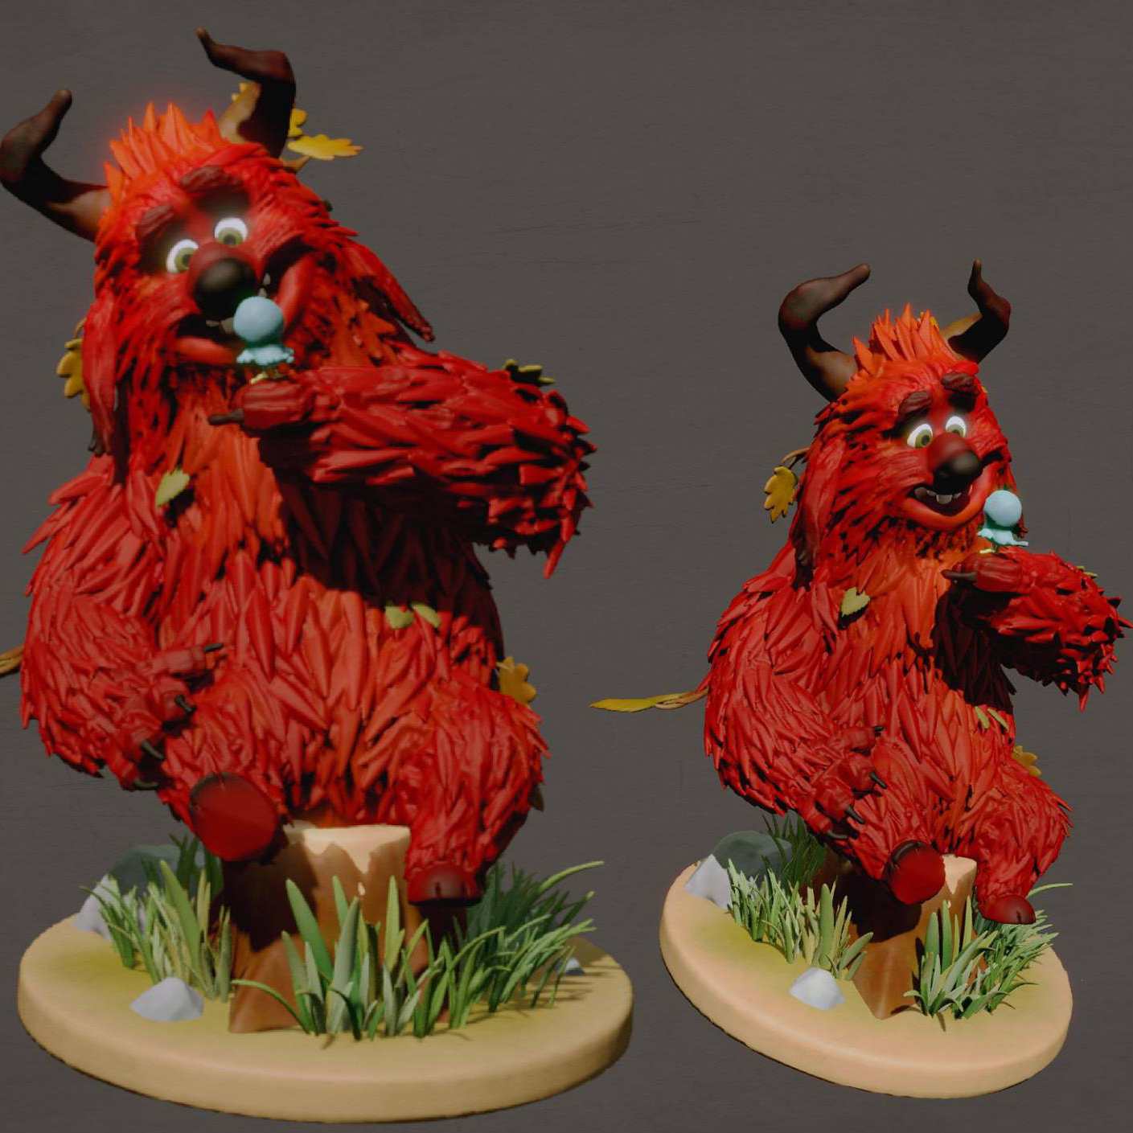
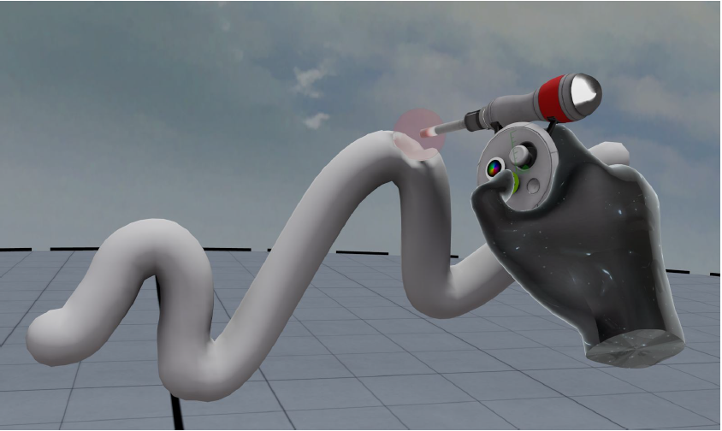
Oculus Medium
Intuitive clay-like modeling
Exporting models in .obj format

Slide 8
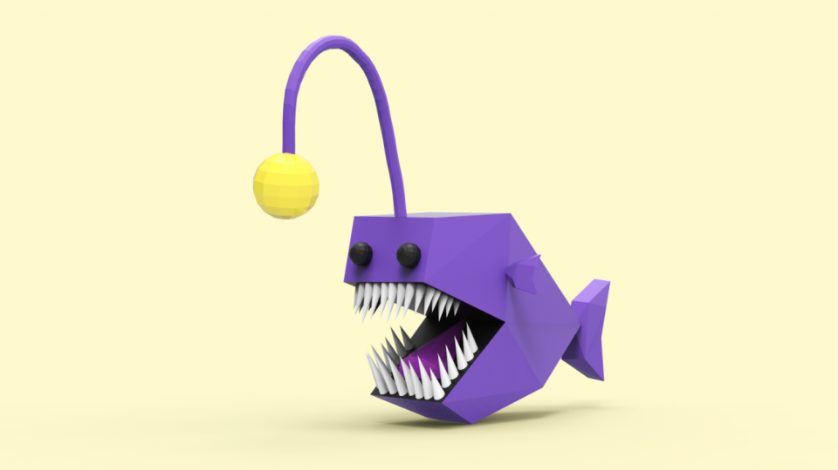
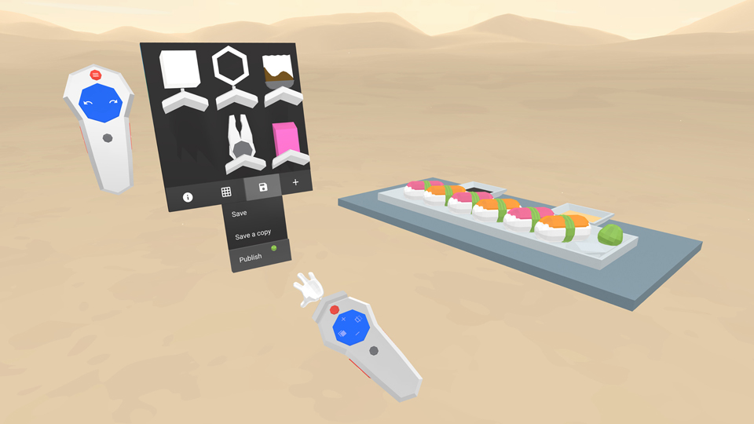
Google Blocks
Provides predefined base shapes (spheres, cubes, cones)
Low-level editing
Low-poly meshes
Exporting models in .obj format
Notes:
Editing on face, vertex and edge level

Slide 9
Motivation
Transfer pen-and-paper drawing skills
Intuitive editing
Utilizing 3D space
Real time to avoid motion sickness

Slide 10
SketchMeshVR

Slide 11
System components
Oculus Rift + Touch controllers
FiberMesh (Nealen et al. 2007)
Libigl
Multithreaded rendering + linear solving

Slide 12
FiberMesh algorithm
Curve deformation
Differential coordinates with co-rotational methods
Notes:
User first deforms the curve(s) and the new positions are then fed into the surface optimization step as positional constraints. Steps are interleaved when pulling on a curve, to provide interactive updates for both.
Geometry is represented by differential coordinates, new vertex positions are obtained by solving a series of linear least-squares problems while satisfying the user-defined positional constraints.
Finding suitable rotations for the diff. coordinates is main challenge, as one approach asks users to define them (not desirable in sketch-based paradigm) or other approach is to derive rotations as linear combinations of vertex positions but this isn’t possible along a curve since vertices are nearly collinear.
Solve a system for vertex position and linearized incremental rotations (skew symmetric matrix, no shearing, stretching or scaling). Target gross rotations Ri become ri*Ri (which is then orthonormalized with polar decomposition). Iterated twice to get Ri and then used to solve for v with L1.
Here L(.) is the differential operator (which starts as first order to iteratively obtain Ri (L0 = v_{i} – v_{i-1}), and switches to second order to obtain final vertex positions (L1 = v_{i} – 1\|Ni|*sum(v_{j})with j in Ni)), ri is incremental rotation, Ri is gross rotation from previous iteration, delta_i is original differential coordinates, vi’ is constraint positions, E contains curve edges, C1 and C2 contain the ROI vertices (originally C1 is at ends of ROI + handle vertex and C2 is at ends of ROI).
Term 1 minimizes difference between resulting diff. coordinates and rotated original differential coordinates delta.
Term 2 are the positional constraints
Term 3 ensures smoothly varying rotations along the curve
Term 4 represents rotational constraints (two, at boundary of ROI)
Size A = (#curve_V*12 + #fixed*6) * (#curve_V*6) (3 for each vertex term 1, 3 for each constraint term 2, 9 for each edge term 3, 3 for each constraint term 4

Slide 13
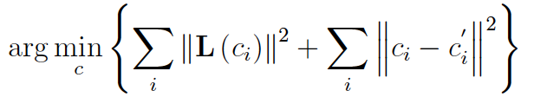
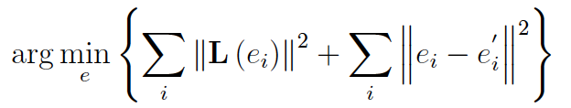
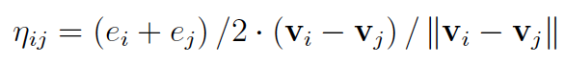

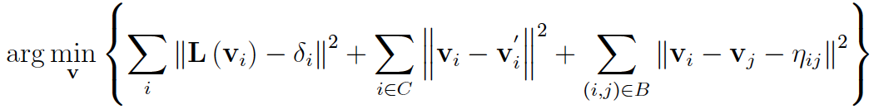
FiberMesh algorithm
Surface optimization
Geometry-independent linear systems
Notes:
Geometry-independent for speed.
Problem 1 solves for Laplacian Magnitudes c (which approximate scalar mean curvature values), with term 1 requiring neighboring LMs to vary smoothly, and term 2 requires all LMs ci to be near the current ci’. Ci’ is initially set to the scalar mean curvature along the curve (with only constraint vertices included) and from later iterations includes all vertices (norm of the second order vertex laplacian).
We need problem 2 to account for the fact that we use the uniformly discretized Laplacian as an estimator of the integrated mean curvature normal. CONDITION is that edges around a vertex all have equal length, otherwise doesn’t hold. SO we prescribe target edge vectors to try and achieve this (while avoiding having to recompute the system matrices every step with a geometry-dependent approach).
Problem 2 solves for target average edge lengths, with term 1 aiming for smoothly varying average edge lengths, and term 2 requiring all average edge lengths to stay close to the current average edge lengths. Iteration 0 only uses edge lengths along boundary curves. This linear system can reuse the factorized matrix from problem 1.
Use these average edge lengths to compute the target edge vectors, nabla_ij.
Then Problem 3 solves for the vertex positions, with term 1 requiring the vertex Laplacians all to be close to the integrated target Laplacians (delta = Ai * ci * ni, with Ai an area estimate for vertex i, ci the target LM and normal ni based off current face normals), the second term placing positional constraints on all constrained vertices and term 3 to require the edge vectors to be close to the target edge vectors (for edges incident on the constrained curves with 1 vertex).
Repeat 5-10 times for convergence
1A & 2A = (#V*2) * (#V)
3A = (#V+#boundary_V+#boundary_incident_V) * (#V)

Slide 14
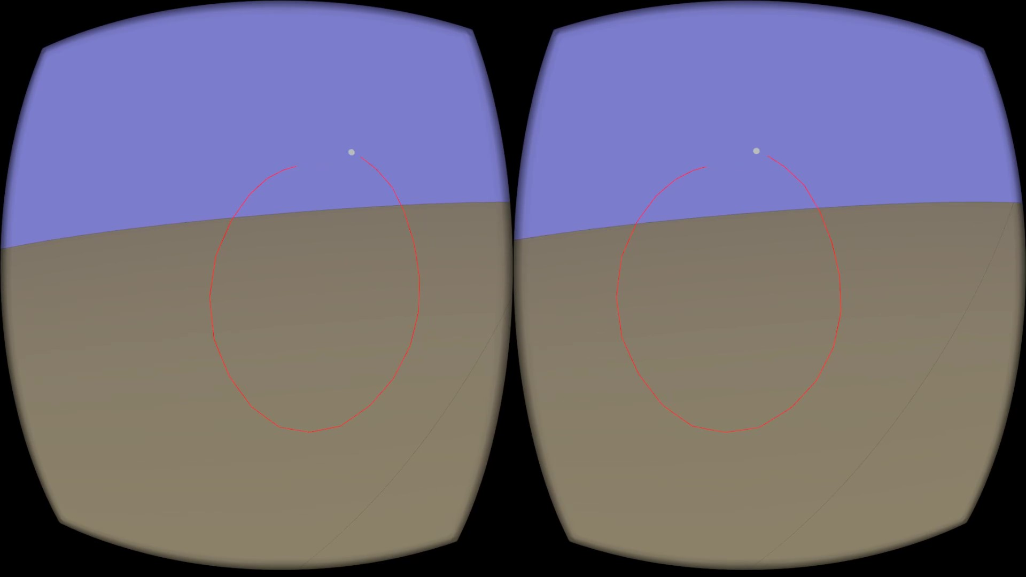
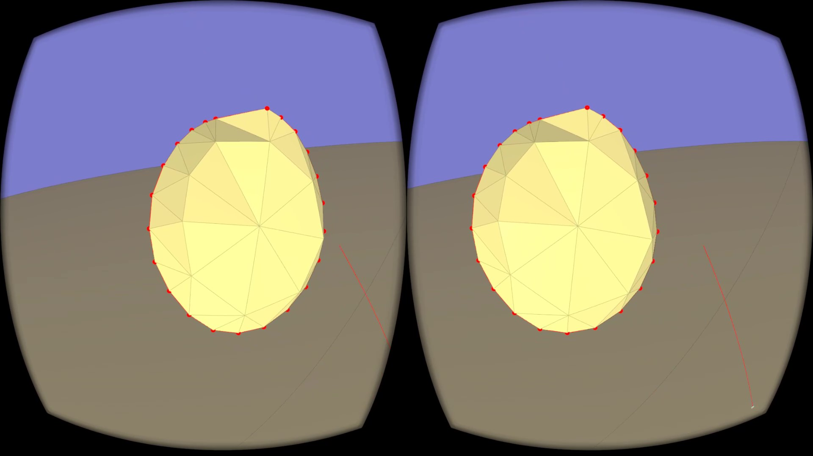
Drawing
Uses hand position

Slide 15
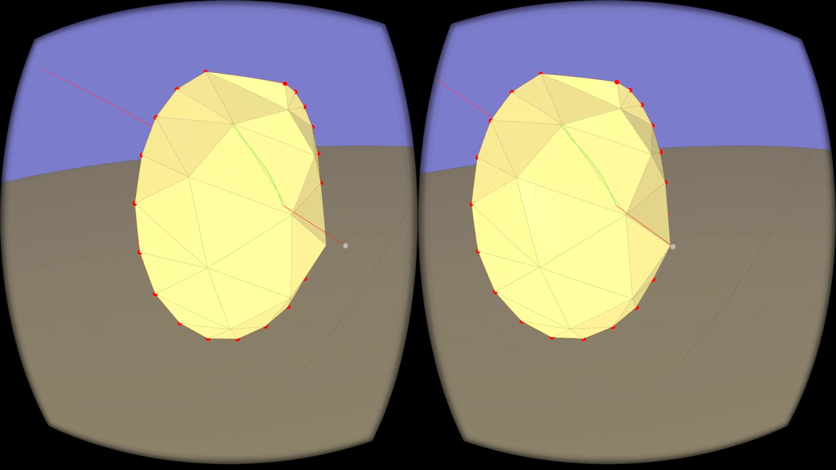
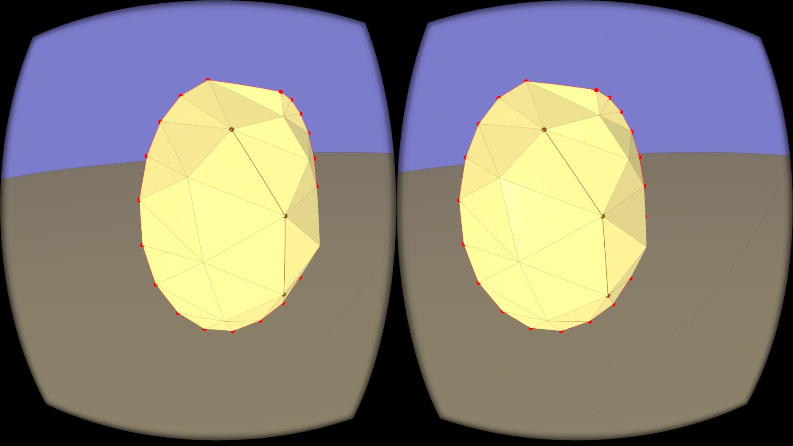
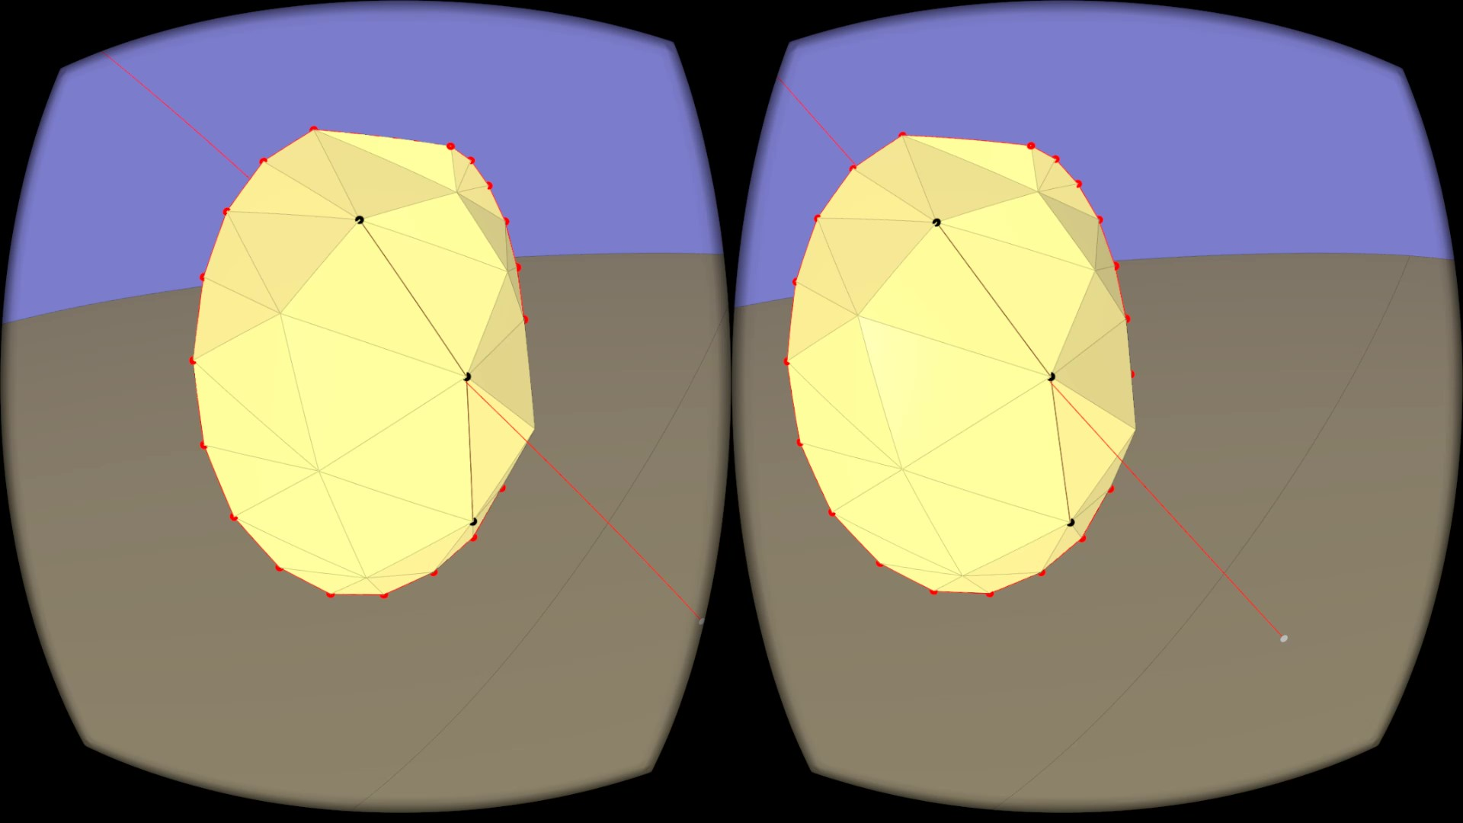

Adding and removing curves
Adding
Removing
Uses ray-mesh intersection

Slide 16
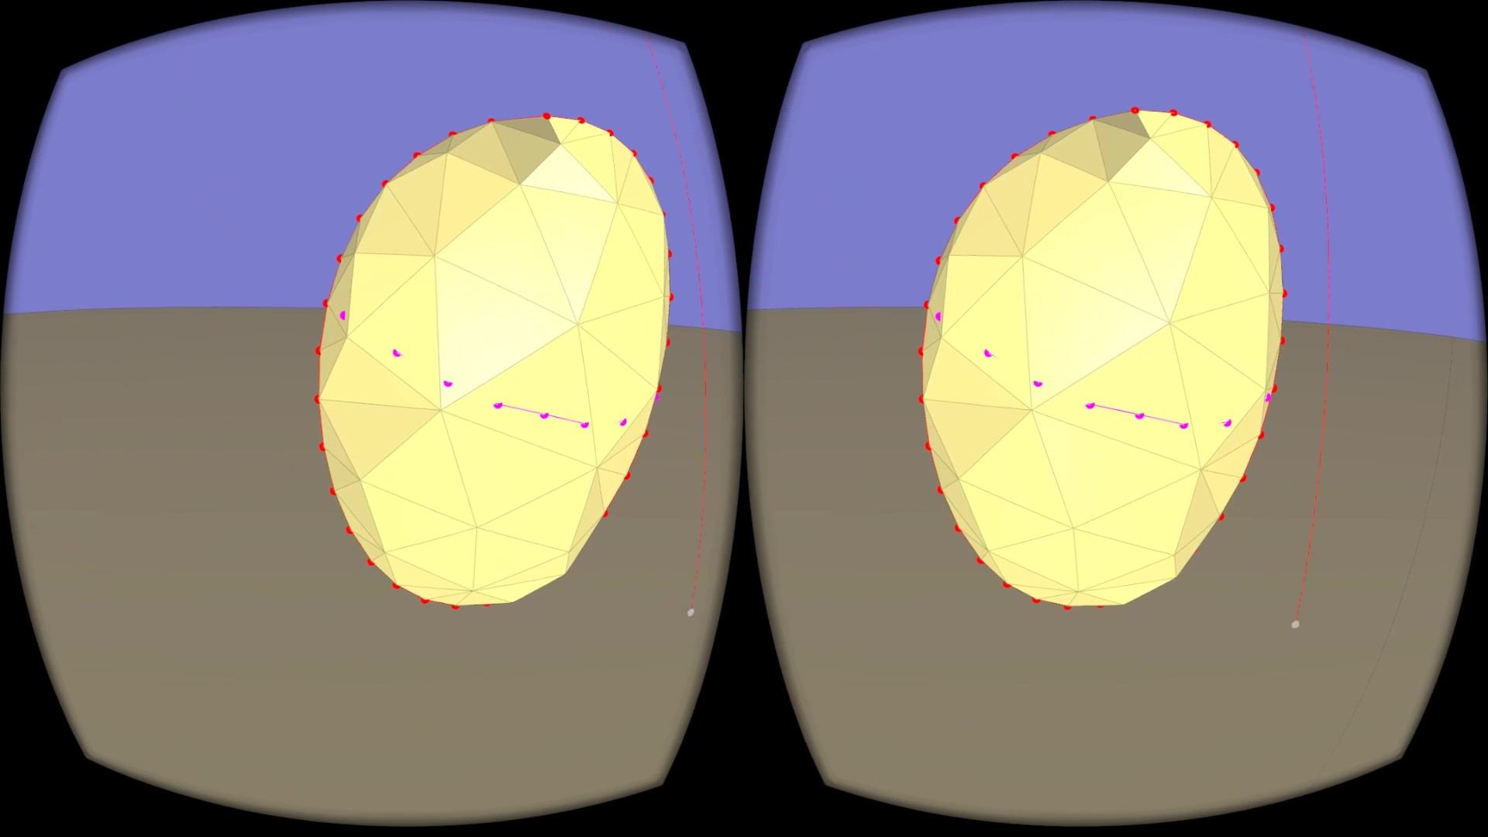
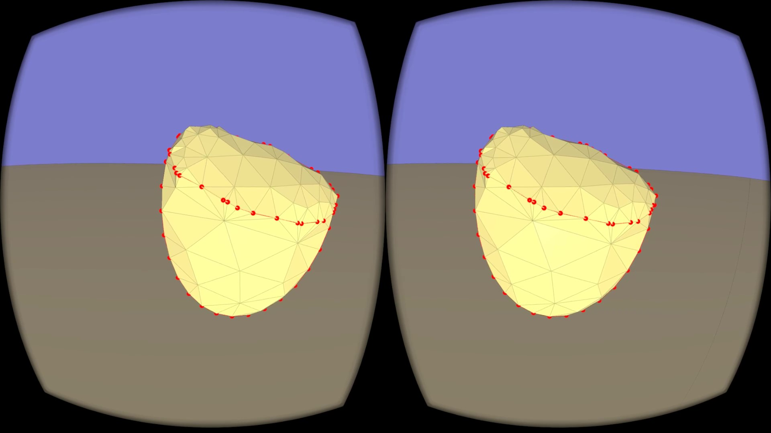
Cutting
Uses ray-mesh intersection

Slide 17
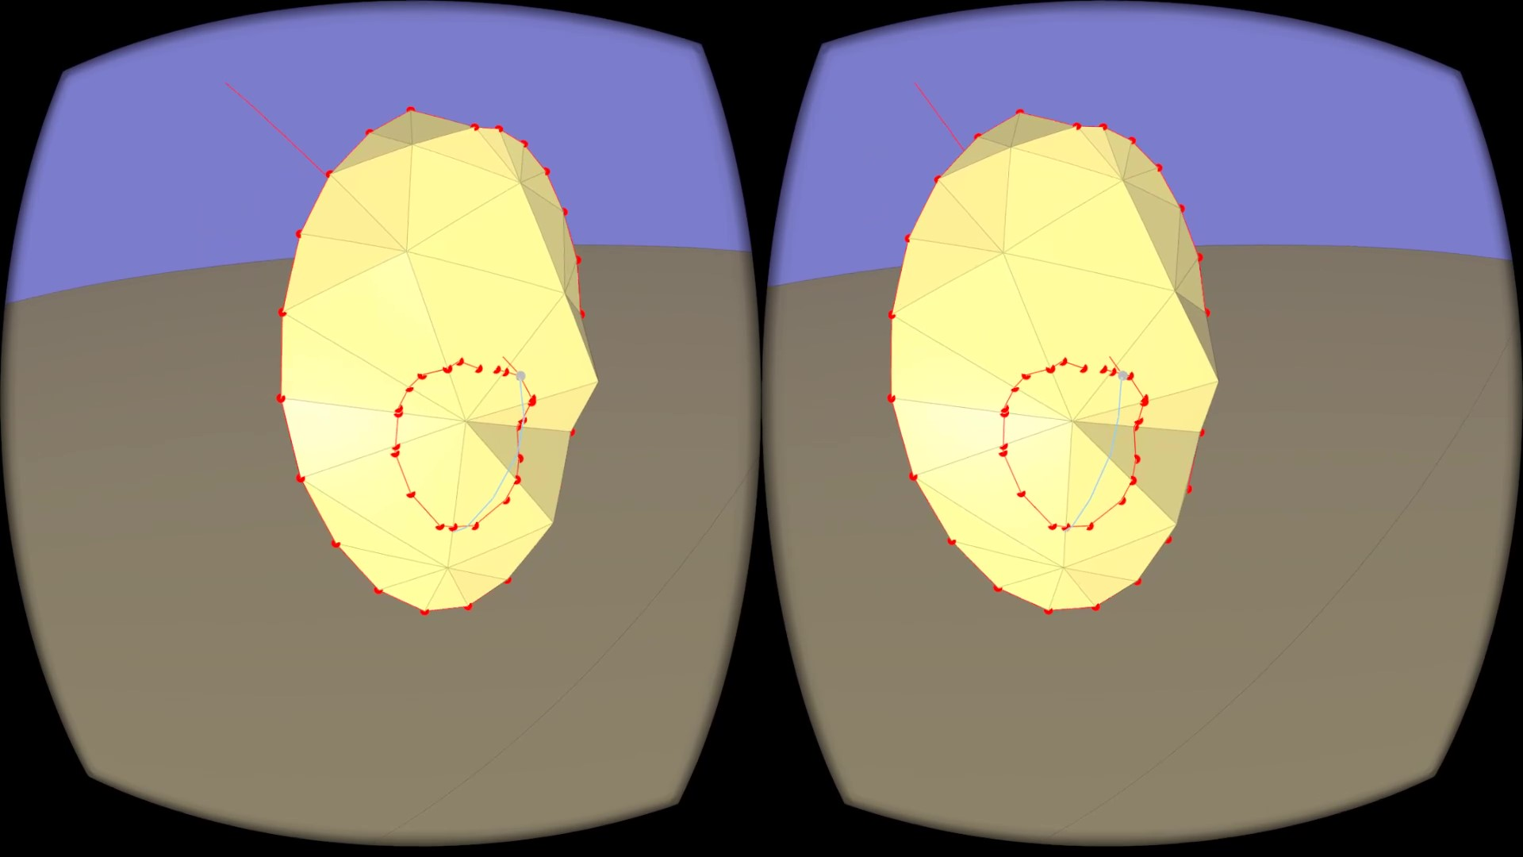
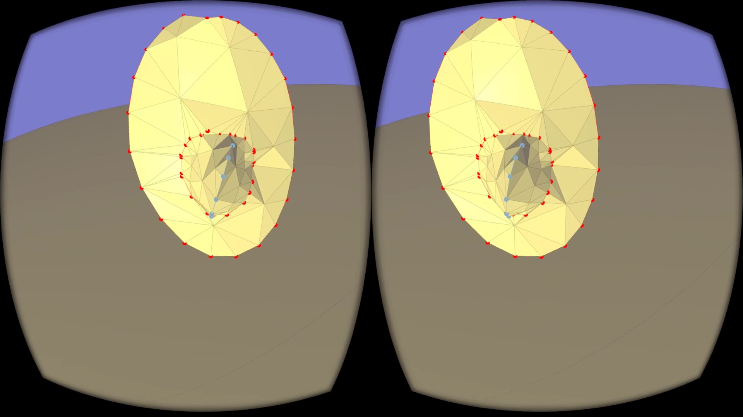
Extrusion
Uses ray-mesh intersection for base and hand position for silhouette

Slide 18
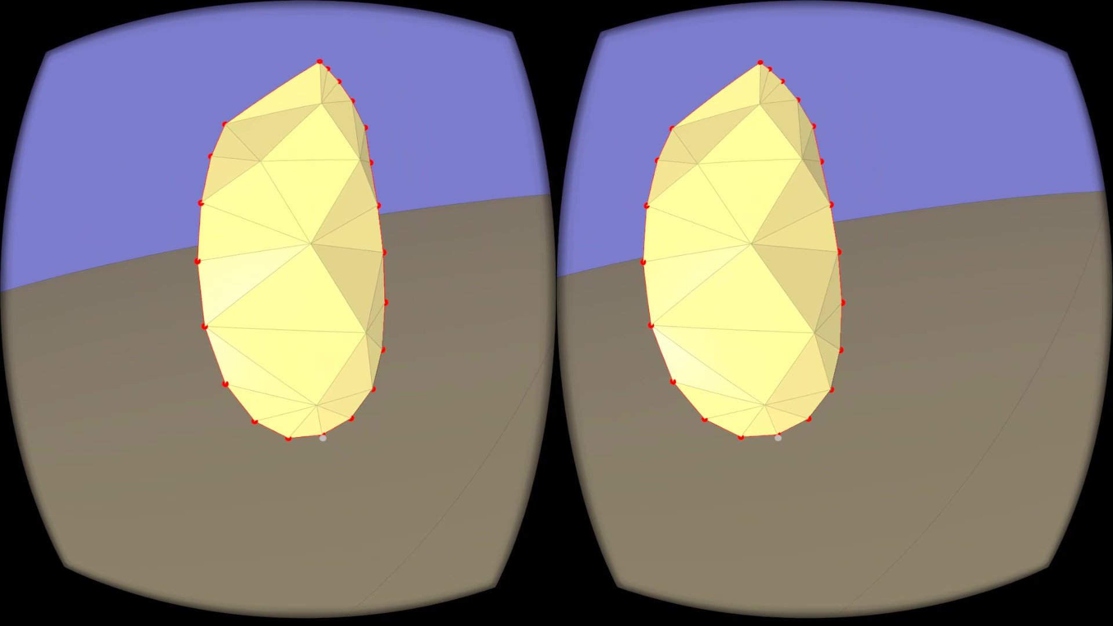
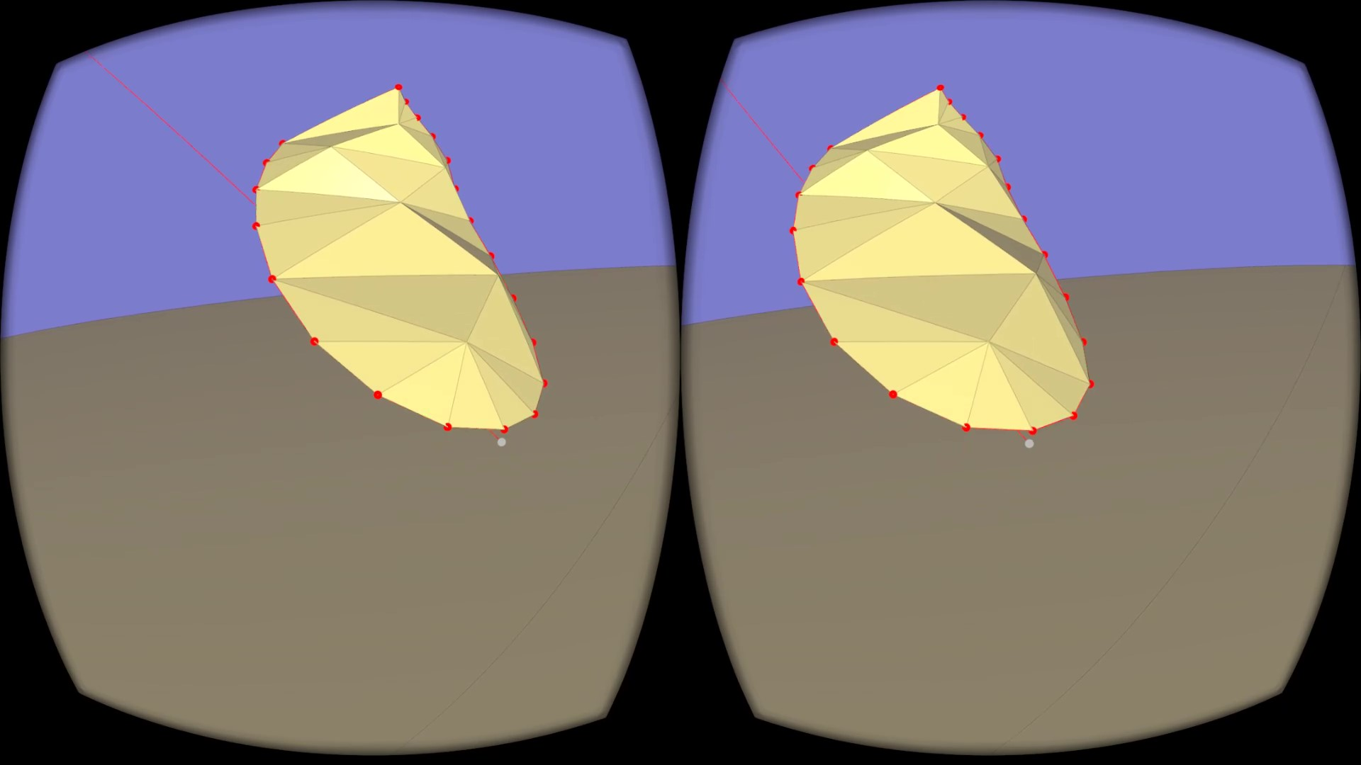
Curve deformation
Uses hand position

Slide 19
Novel contributions
First silhouette sketch-based method in VR
Out-of-plane editing
Curve deformation
Diagonal cuts
Extrusions
Notes:
Compared to non-VR we have introduced out-of-plane editing.

Slide 20
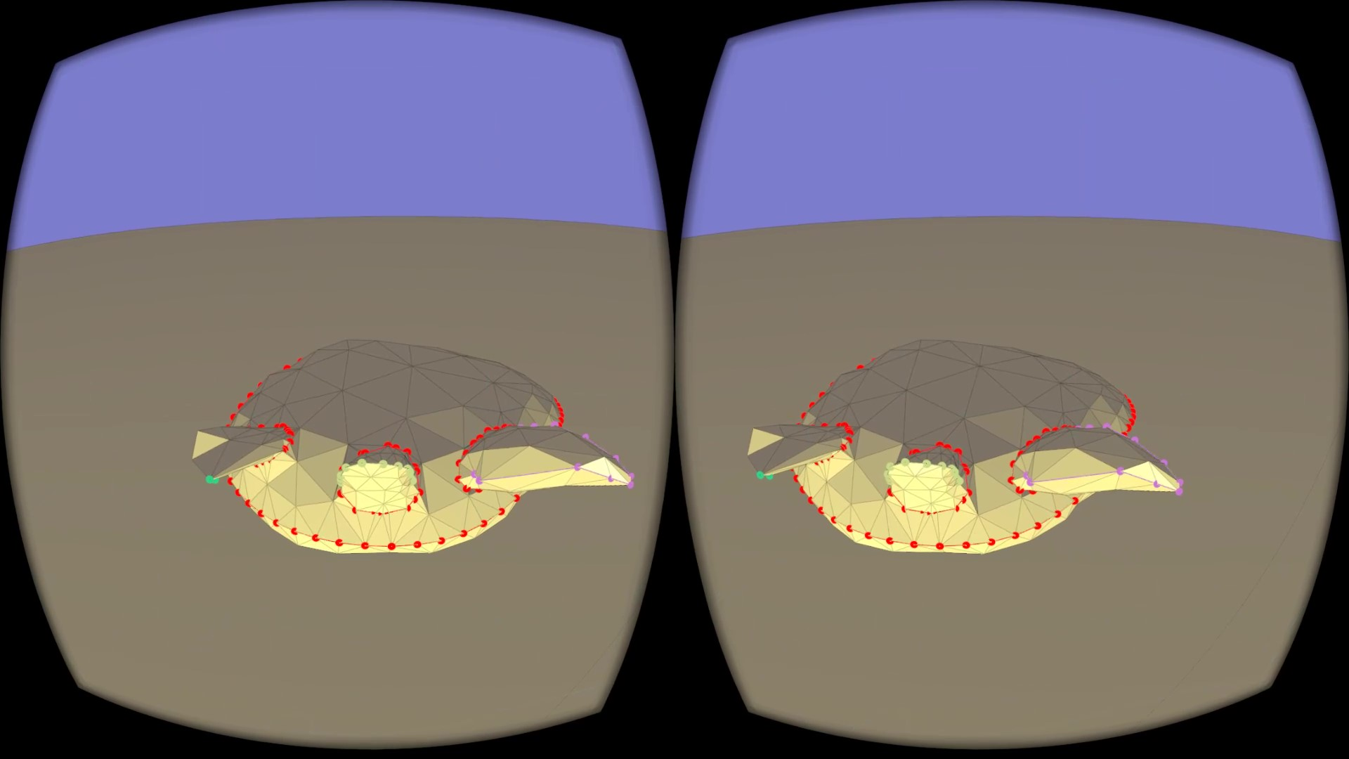
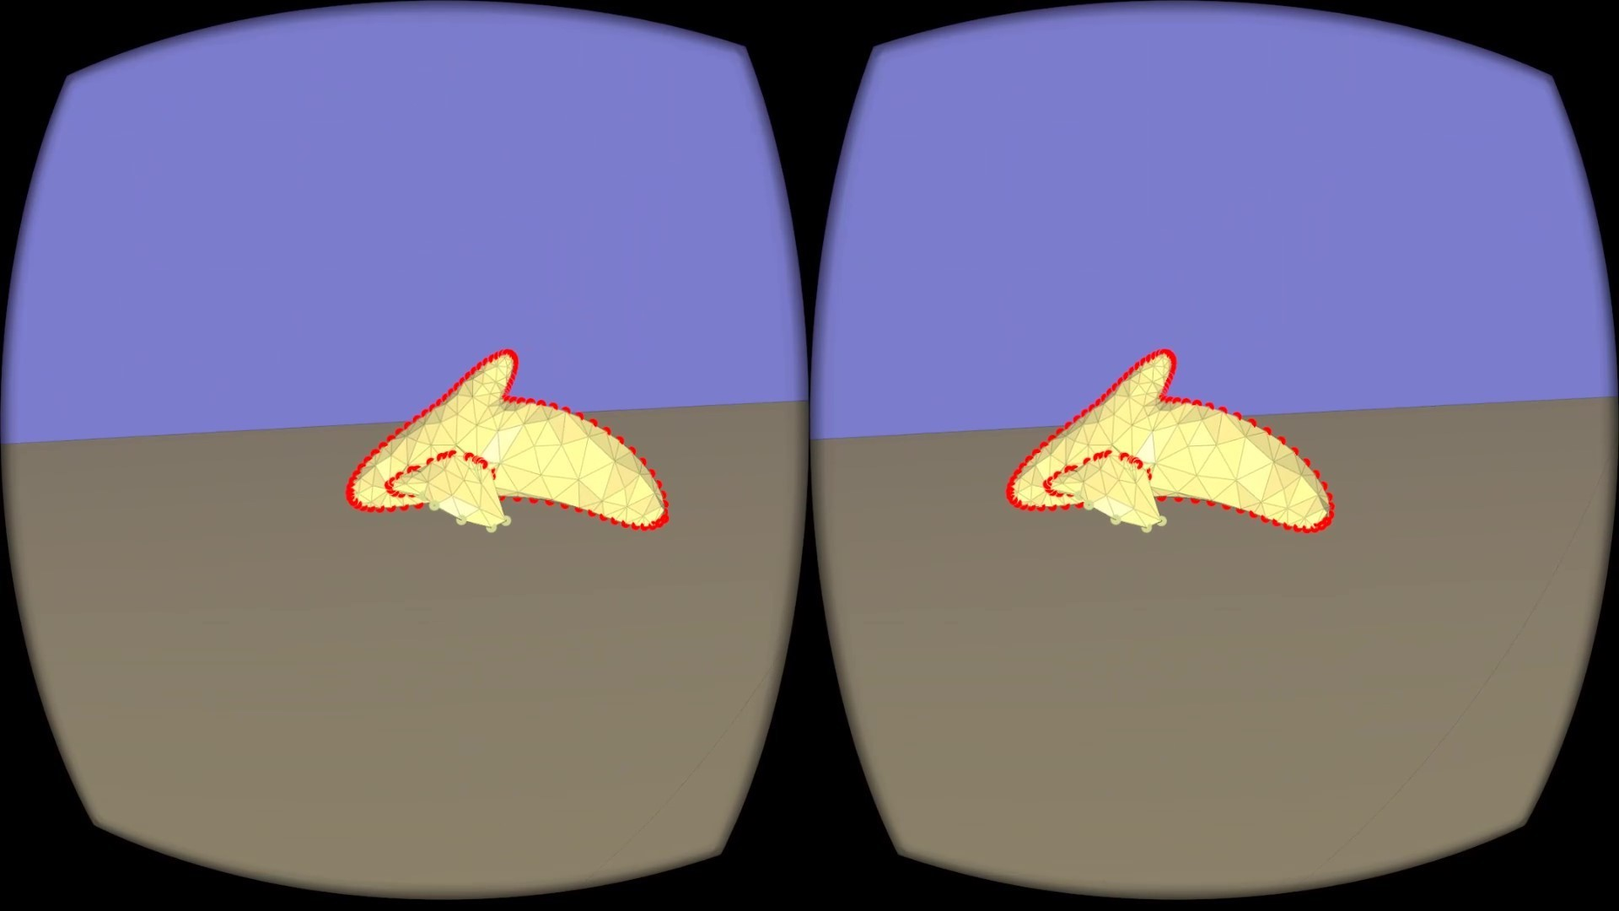
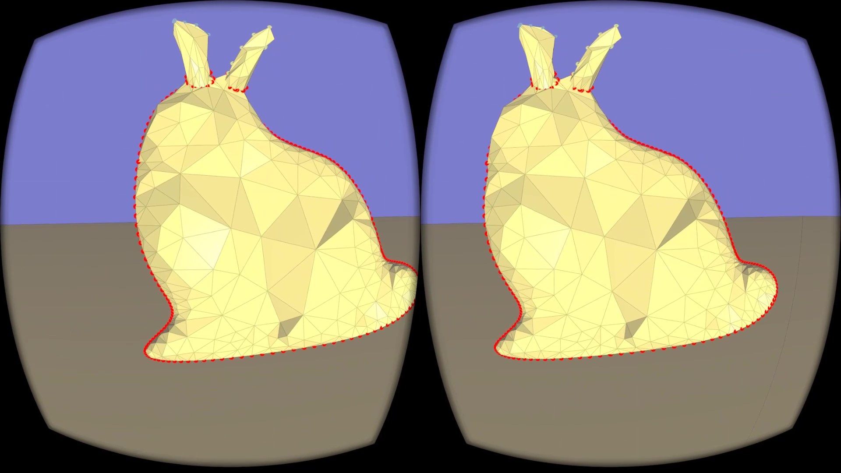
Some results
5 minutes
7 minutes
9 minutes

Slide 21
Evaluation
Advantages
Out-of-plane editing
Tactile 3D feedback
Sense of scale
Disadvantages
Less precise
Quicker fatigue
Requires more space

Slide 22
Future work
Feedback on currently selected tool
Mesh navigation in small space
Sharp curve deformation
Undo button
More polished interface

Slide 23
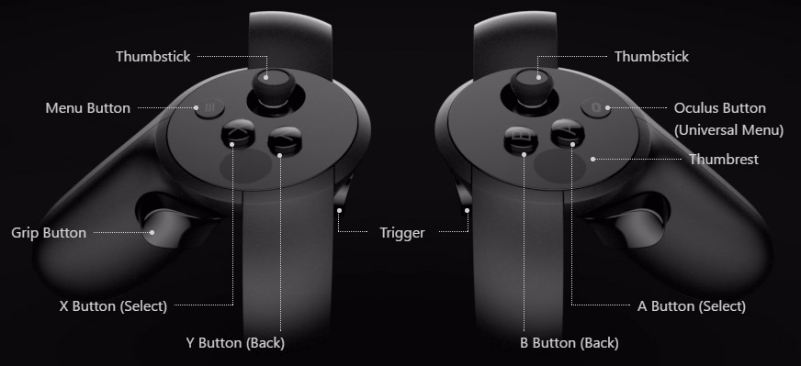
Demo
Action button | Toggle button | Actions
Grip + Trigger | B button | Draw & pull
Grip | A button | Cut & extrude
Trigger | Thumbstick | Add & remove curves

Slide 24
Thank You

